Slide 1
Chapter 3
Physical Development
Notes:
Add slide notes here

Slide 2
Growth and Physical Development in Infancy and Childhood (1 of 4)
Patterns of Growth
Cephalocaudal development: growth proceeds from head downward
Proximodistal development: growth proceeds from center of body outward
Notes:
Learning Objective: 3-1: Summarize patterns of body growth and biological and contextual influences on growth during infancy and childhood.
I. Growth and Physical Development in Infancy and Childhood
A. Patterns of Growth
a. Cephalocaudal development: the principle that growth proceeds from the head downward
b. Proximodistal development: the principle that growth and development proceed from the center of the body outward

Slide 3
Growth and Physical Development in Infancy and Childhood (2 of 4)
Growth in Infancy
Most rapid growth of lifespan
Growth norms: expectations for typical gains and variations in height and weight for children based on chronological age and background
Notes:
Learning Objective: 3-1: Summarize patterns of body growth and biological and contextual influences on growth during infancy and childhood.
B. Growth in Infancy
Growth norms: expectations for typical gains and variations in height and weight for children based on their chronological age and ethnic background. Dealing w/ averages!
Infants usually double their birth weight at 4 months, triple it by 12 months
c. Infants grow 10-12 inches in height over the first year

Slide 4
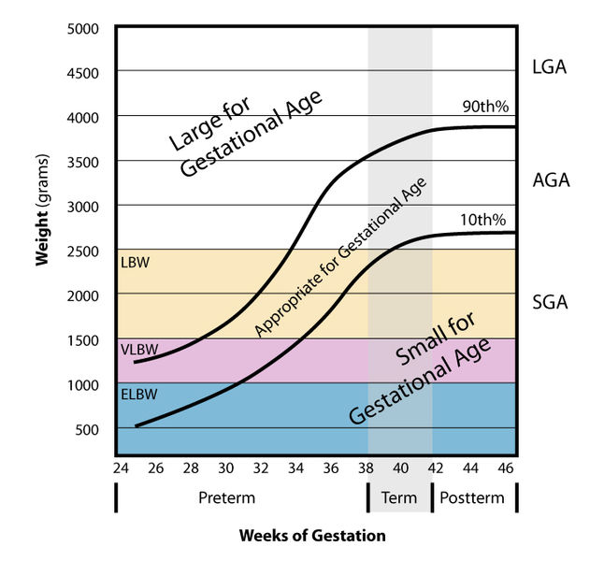
Size Norms
Notes:
Learning Objective: 3-1: Summarize patterns of body growth and biological and contextual influences on growth during infancy and childhood.
B. Growth in Infancy
Growth norms: expectations for typical gains and variations in height and weight for children based on their chronological age and ethnic background. Dealing w/ averages!
Infants usually double their birth weight at 4 months, triple it by 12 months
c. Infants grow 10-12 inches in height over the first year

Slide 5
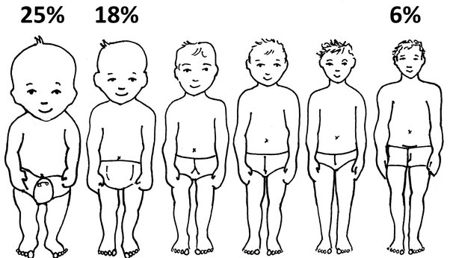
Growth of the Body
Infants are not “scaled-down” versions of adults
Head and trunk grow more quickly than other parts of the body
  “Top-heavy” appearance

Slide 6
Height and Weight (1)
The average American newborn is 20 inches long and weighs 7.6 pounds.
Most of the newborns are 18 to 22 inches long and weigh between 5 and 10 pounds.
Babies grow about 1 inch per month during the first year.

Slide 7
Height and Weight (2)
However, average is not the same as normal!
  Children of the same age can vary greatly in their heights and weights!
Height and weight both depend on heredity.
  Strong correlation between parents’ height and child’s height by the age of two

Slide 8
Nutrition and Growth (1 of 2)
Rapid growth = Rapid calories consumption!
A typical 2-month-old expends roughly 40% of their body’s energy on growth
Because of growth requires so much energy, young babies require lots of calories (50 per pound of weight)
  Compared to 15-20 in adults

Slide 9
Rapid Growth
Infants grow rapidly!
  Gaining an ounce of weight/day and an inch in length/month
  At birth, most bones are soft, pliable, and difficult to break.
By age 2:
  Attained about half of their eventual adult height and weigh 27–30 pounds on average

Slide 10
Nutrition and Growth (2 of 2)
By age 2, growth slows, and children require less nutrition
Kids start to become picky eaters
Annoying for parents but maybe adaptive?
  Toddlers don’t know what is and isn’t safe to eat, so only eating familiar food may be a method to protect from harm

Slide 11
Malnutrition
Worldwide, about one in four children under age 5 are malnourished
Malnourished children tend to be:
  small for their age.
  listless, quiet, and inactive.
Problem! Easily overlooked!

Slide 12
Growth and Physical Development in Infancy and Childhood (3 of 4)
Growth in Early Childhood
Growth slows down!
Ossification: the process that results in gains in height and arm-span
  Legs and arms grow stronger and harder bones
Notes:
C. Growth in Early Childhood
a. Young children become leaner, gaining muscle and losing fat
c. Continued cephalocaudal trend
d. Ossification: the process in early childhood growth that results in gains in height and arm-span as the legs and arms grow and stronger and harder bones

Slide 13
Growth and Physical Development in Infancy and Childhood (4 of 4)
Growth in Middle Childhood:
Growth continues to slow
  2-3 inches per year; 5-8 pounds per year
Growing pains: intermittent aches and stiffness in the legs often experienced at night that are caused by the stretching and molding of the muscles to fit the child’s growing skeleton
Influenced by health and environmental factors
Notes:
Learning Objective: 3-1: Summarize patterns of body growth and biological and contextual influences on growth during infancy and childhood.
D. Growth in Middle Childhood
a. Growth slows considerably
c. Grow 2-3 inches, gain 5-8 pounds per year
d. Continued cephalocaudal trend
e. Growing pains: intermittent aches and stiffness in the legs often experienced at night that are caused by the stretching and molding of the muscles to fit a child’s growing skeleton
f. Consistent racial and ethnic differences in patterns of growth in industrialized nations
g. Growth can be influenced by health and environmental factors
i. Socioeconomic status
ii. Improved sanitation, nutrition, and access to medical care

Slide 14
Growth and Physical Development in Adolescence (1 of 3)
Puberty: biological transition to adulthood, in which adolescents mature physically and become capable of reproduction
Changes in Body Shape and Size
Adolescent Growth Spurt: rapid gain in height and weight in adolescence
Onset is earlier in girls than boys
Notes:
Learning Objective: 3-2: Examine the physical changes that occur with puberty, influences on pubertal timing, and the psychosocial effects of early and late puberty.
II. Growth and Physical Development in Adolescence
A. Puberty: the biological transition to adulthood in which adolescents mature physically and become capable of reproduction
B. Changes in Body Shape and Size
a. Adolescent growth spurt: a rapid gain in height and weight that generally begins in girls at about age 10 and in boys at about age 12

Slide 15
Adolescent Growth Spurt (1 of 2)
Triggered by an increase in the level of growth hormones circulating through the body during adolescence
Girls’ peak rate of growth for height is 12 years, and for weight, it is 12.5 years.
Boys’ peak rate of growth for height is 13.4 years, and for weight, it is 13.9 years.

Slide 16
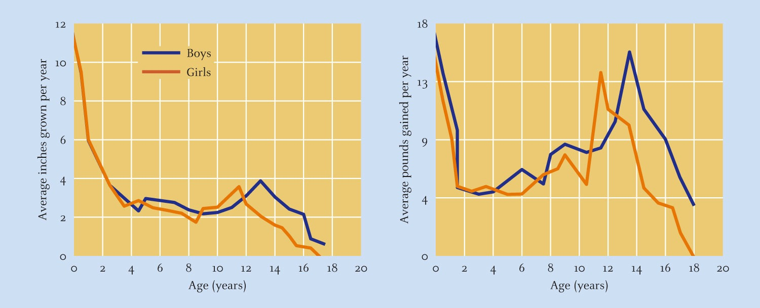
Adolescent Growth Spurt (2 of 2)
Notes:
Figure 8.1 Children grow steadily taller and heavier until puberty, when they experience a rapid increase known as the adolescent growth spurt.

Slide 17
Brain Growth in Adolescence
By the beginning of adolescence, the brain is 95% of adult size and weight
Not all brain regions reach maturity!
  Brain systems responsible for self-control are not fully specialized until adulthood

Slide 18
Growth and Physical Development in Adolescence (2 of 3)
Emergence of Secondary Sex Characteristics:
Secondary Sex Characteristics: body changes that indicate physical maturation but are not directly related to fertility
Changes in voice, skin, and hair
Notes:
C. Emergence of Secondary Sex Characteristics
a. Secondary sex characteristics: body changes that indicate physical maturation but are not directly related to fertility
b. The body changes that indicate physical maturation but are not directly related to fertility
c. Breast development--first sign of puberty in girls
d Changes in voice, skin, and hair
e. Reproductive organs are known as primary sex characteristics

Slide 19
Growth and Physical Development in Adolescence (3 of 3)
Pubertal Timing and Adolescent Development:
Early Maturation:
  Girls: negative effects
  Boys: more positive effects, but be negative
Late Maturation:
  Girls: positive effects
  Boys: more negative effects
Notes:
Learning Objective: 3-2: Examine the physical changes that occur with puberty, influences on pubertal timing, and the psychosocial effects of early and late puberty.
F. Pubertal Timing and Adolescent Development
a. Early Maturation
i. Early-maturing adolescents are more likely to:
1. Be treated in ways similar to older adolescents, which may increase stress
2. Engage in risk activity
3. Form internalizing behaviors
ii. Early maturation in girls
1. Tends to increase body dissatisfaction
2. Higher rates of depression, anxiety, low self-esteem, and problem behavior
3. May pose social and sexual risks
iii. Early maturation in boys
1. Tend to be athletic, popular, confident leaders
2. May experience internalizing and externalizing symptoms
3. Can be particularly damaging for adolescents of color
b. Late Maturation
i. Tends to have a protective effect on girls
ii. Late-maturing boys may experience more social and emotional difficulties, but research is conflicting
c. Context and the Effects of Pubertal Timing
i. Peer context
1. Spending time with older adolescents can result in age-inappropriate behaviors (especially in girls)
2. Composition of peer group (i.e., more vs. less boys) can also have an effect on the risk for adolescent dating abuse
ii. School context
1. Early-maturing Black girls who perceive themselves as early-maturing report more discrimination experiences than their peers
iii. Race and pubertal timing
1. Stress that accompanies discrimination may pose risks, but the effects are complicated

Slide 20
Rate of Maturation
Early maturer: 11 (boys); 9 (girls)
Late maturer: 15–16 (boys); 14–15 (girls)
Late transition to puberty has few long-lasting effects for boys or girls

Slide 21
Puberty Timing
Girls experiencing puberty tend to become self-conscious about their appearance.
Boys are more likely to welcome their weight gain and voice changes.
Later-developing boys tend to perform poorly on school achievement tests.
Later-developing girls outperform other students.
Early-maturing girls have a greater likelihood of experiencing long-term adjustment problems, including anxiety and depression.

Slide 22
Physical Development in Adulthood (3 of 4)
Changes to Body Composition
Sarcopenia: the age-related loss of muscle and mass strength that may begin in the 30s, but changes go unnoticed until late midlife
Slowing metabolic rate
Notes:
Learning Objective: 3-3: Outline patterns of physical aging in adulthood and explanations for the causes of aging.
F. Changes to Body Composition
a. Muscle development improves throughout 20s, peaks at ~30
b. Muscle
i. Sarcopenia: the age-related loss of muscle and mass strength that may begin in the 30s, but changes go unnoticed until late midlife
ii. Rate of decline in muscle mass tends to accelerate in the 40s
iii. Isometric strength: the subtle contractions used to hold a hand grip, push off against a wall, stretch, or practice yoga that is maintained throughout adulthood
c. There are individual differences in strength loss
d. Body Fat
i. Metabolic rate slows
ii. Men and women tend to gain weight in middle adulthood
iii. Active lifestyle and weight-bearing physical activity can reduce muscle loss and produce gains in muscular density
iv. Gradual adjustments in diet can minimize weight gain
d. Bone
i. Bone density peaks in late 30s, gradually declines after
ii. Bones become thinner, more porous, more brittle
iii. Bone loss increases in 50s, especially in women
iv. Osteoporosis: a disorder entailing severe bone loss that leads to brittle and easily fractured bones
v. Disk collapse results in loss of height
vi. Losses can be slowed by behavior (i.e., avoiding smoking and excess drinking and engaging in weight-bearing exercise)

Slide 23
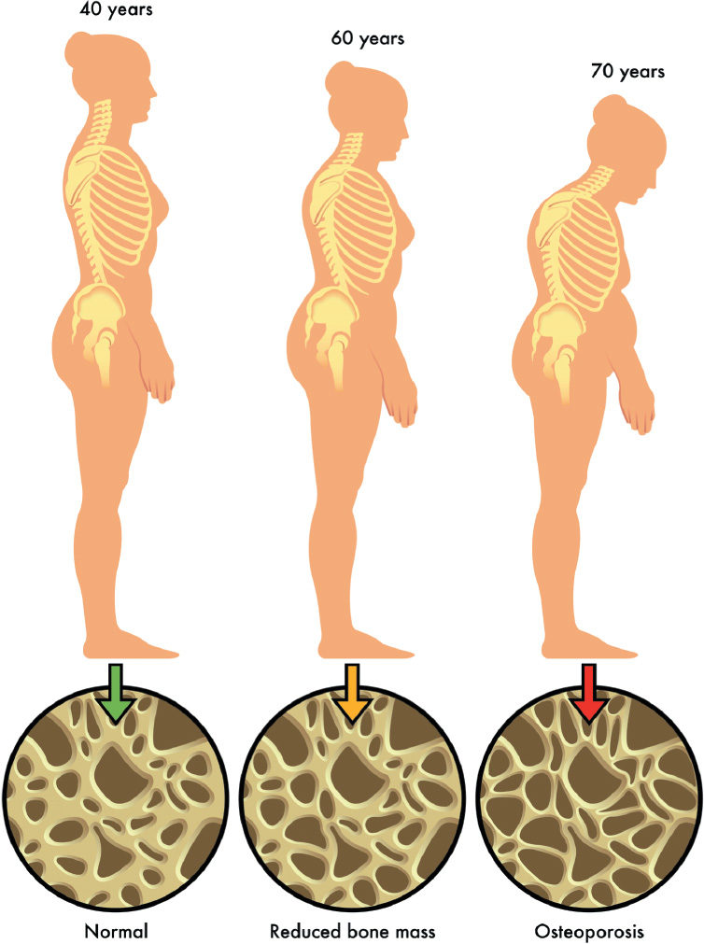
Health and Wellness
Osteoporosis:
  Disease in which a serious loss of minerals leaves the bones fragile and easily fractured
  One-third of elderly adults who fracture a hip die within 1 year.
Osteoarthritis:
  Results from gradual deterioration of the cartilage that cushions the bones from rubbing against one another

Slide 24
Physical Development in Adulthood (4 of 4)
Cardiovascular, Respiratory, and Immune Systems
Atherosclerosis: arteries stiffen and walls accumulate cholesterol and fat plaques, which reduce blood flow; a cause of heart disease
Loss of elasticity in lungs
Immune system becomes less adaptive and less efficient
Notes:
Learning Objective: 3-3: Outline patterns of physical aging in adulthood and explanations for the causes of aging.
G. Cardiovascular, Respiratory, and Immune Systems
a. Heart experiences cell loss, becomes more rigid, is less responsive to pacemaker cells’ signals
b. Atherosclerosis: a condition in which arteries stiffen and walls accumulate cholesterol and fat plaques, which reduce blood flow and which is a cause of heart disease
c. Lungs gradually lose cells and elasticity, reducing the amount of oxygen that enters the system
i. More trouble breathing
ii. More out of breath during physical exertion
iii. Harder time catching breath
iv. Influenced by smoking and exposure to environmental toxins, level of activity, and nutrition
d. Immune system becomes less adaptive and efficient
i. Higher risk of diseases (i.e., flu, pneumonia, cancers, autoimmune diseases)
ii. Influenced by stress
iii. Less effective T cells, more likely to turn against body tissues

Slide 25
Brain Changes in Adulthood
Aging brain
  Shrinking, slowing brain
    Brain loses 5% to 10% of its weight between ages 20 to 90
    Brain volume decreases due to:
      Shrinkage of neurons
      Lower numbers of synapses
      Reduced length and complexity of axons
      Reduced tree-like branching in dendrites

Slide 26
Physical Development in Adulthood (1 of 4)
Senescence: pattern of gradual age-related declines in physical functioning
Why do we age?
  Genetics?
  Free Radicals?
    Highly corrosive molecules that form when oxygen corrodes a cell and strip off an electron, slowly decays cells
Notes:
Learning Objective: 3-3: Outline patterns of physical aging in adulthood and explanations for the causes of aging.
III. Physical Development in Adulthood
A. All organs peak and begin to age
B. Senescence: a pattern of gradual age-related declines in physical functioning
C. Theories of Aging
a. “Use it or lose it”—activity is a critical component of a long, healthy life
b. Genetics
i. Biological program that unfolds over time
ii. Set of genetic factors that interact with environmental factors may predict life span
iii. Aging influenced by epigenetics
b. Environment and Free Radicals
i. Cellular mutation—damage to DNA and chromosomes
ii. Free radicals: highly reactive and corrosive molecules that form when oxygen corrodes a cell and strip off an electron, destroying cellular materials to replace the missing electrons
1. Cancer
2. Cardiovascular disorders
3. Arthritis
4. Predict mortality
5. Antioxidant-rich diet may protect against damage
6. Complex process influenced by many factors

Slide 27
Why do we age? – Theories (1 of 2)
Cellular Theories
  Aging processes that occurs within individual cells
  Genetic and environmental influences
Programmed Aging Theory (Hayflick, 1965)
  “Hayflick Limit”
    Cells hardwired for a fixed number of divisions
    Cell death occurs when limit is reached

Slide 28
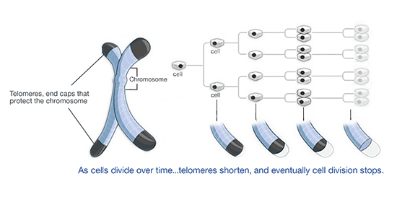
Physical Development in Adulthood (2 of 4)
Telomere Length and Cell Division
  Telomeres: tiny caps of DNA located at both ends of the chromosomes that become shorter each time the cell divides
Notes:
Learning Objective: 3-3: Outline patterns of physical aging in adulthood and explanations for the causes of aging.
c. Telomere Length and Cell Division
i. Cells have limited capacity to reproduce (~50 times in their life span)
ii. Telomeres: tiny caps of DNA located at both ends of the chromosomes that become shorter each time the cell divides
1. Protect the cell from common mutations
2. Reduce capacity to reproduce
3. Telomere length associated with dozens of cancers
iii. Telomere length influenced by epigenetics and behavioral factors
d. Diet and Caloric Restriction
i. Extremely low, nutritious diet associated with longer lifespan and less oxidative stress
ii. Difficult for a human to sustain
e. Inflammation and the Immune System
i. Immune system becomes less able to differentiate healthy cells from pathology with age
ii. Inflammation: immune activity that is not associated with infection or disease (chronic, low-grade)
1. Cardiovascular diseases
2. Cancers
3. Diabetes
3. Black adults and those of low socioeconomic status tend to show more low-grade inflammation and inflammatory biomarkers

Slide 29
Why do we age? – Theories (2 of 2)
  Problem: Even at death, most cells in human body still divide very well
  If there is a limit, most people don’t live long enough to reach it!

